Slide 1

Adventure Works Monthly Sales Performance: Sales Department Summary
By: Sajjad Adil

Slide 2
01
03
Agenda
02
04
Department Summary
Online vs Offline sales
Opportunities and key recommendations
Monthly sales overview

Slide 3
Key Performance Indicators
$9M
$140.65M
39.8%
-2.88%
Total Profit
Total Revenue
Online Profit Margin
Offline Profit Margin
Notes:
To set the stage, let’s begin with a summary of key findings. Over the period analyzed, we saw significant growth, with a 640% increase in sales. Online channels showed a strong profit margin of 39.8%, while offline struggled with a negative margin of -2.88%. Our recommendations focus on expanding profitable online segments, optimizing offline categories, and leveraging our top salespeople to improve team performance.

Slide 4
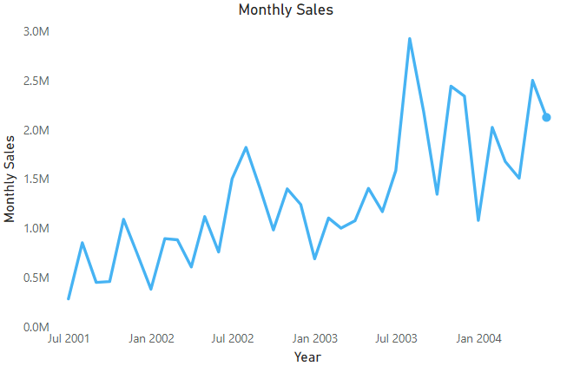
Monthly Sales Overview
Monthly Sales trended up, resulting in a 640% increase between July 2001 and June 2004.
Sales Trend
﻿Monthly Sales started trending up on July 2003, rising by 33.90% in 11 months.﻿
Notes:
Looking at our sales trends, we notice a substantial upward shift starting in July 2003, with a remarkable 33.9% increase over 11 months. This period marks a turning point, and it’s critical to identify what drove this growth to replicate these strategies moving forward. Additionally, we should consider allocating more resources during peak-performing months to maximize our revenue potential.

Slide 5
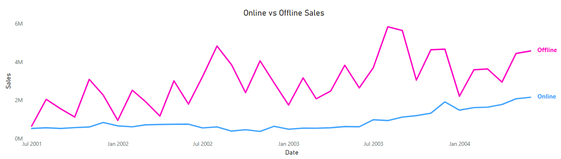
Sales by Channel (Online vs Offline)
We notice that offline sales are larger than online sales, but online sales are increasing.

Slide 6
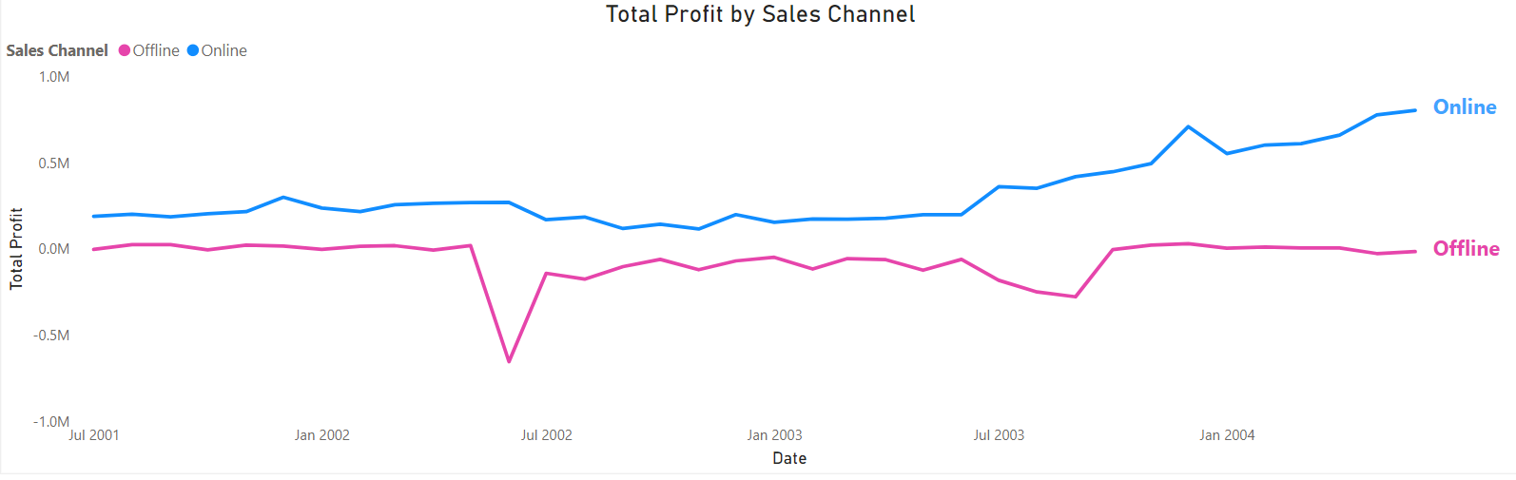
Profit by Online channel is Higher
Although the offline sales are higher, the profit margin generated by online sales is 39.8%, where offline profit margin is -2.88%
Notes:
Now, let’s delve into the performance of our sales channels. Offline sales, while higher in volume, are not yielding profits, with a negative margin of -2.88%. In contrast, online sales, though smaller in volume, are significantly more profitable at 39.8%. To address this disparity, transitioning underperforming offline categories online could prove beneficial, alongside targeted marketing for high-margin online products.

Slide 7
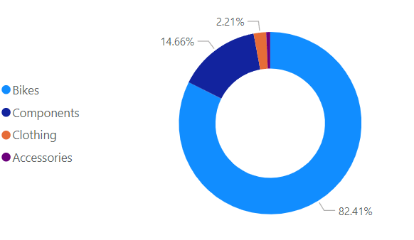
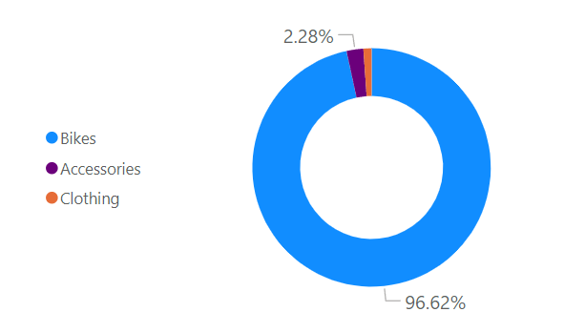
Opportunities and key recommendations
Components category are not sold online, it could be included to generate more sales.
Offline Sales by category
Online Sales by category
Notes:
In terms of product categories, we’ve identified key opportunities. Offline sales need optimization, particularly in low-margin categories, which may need reevaluation. On the other hand, the absence of Components in online sales presents a potential for profit growth if introduced effectively.

Slide 8
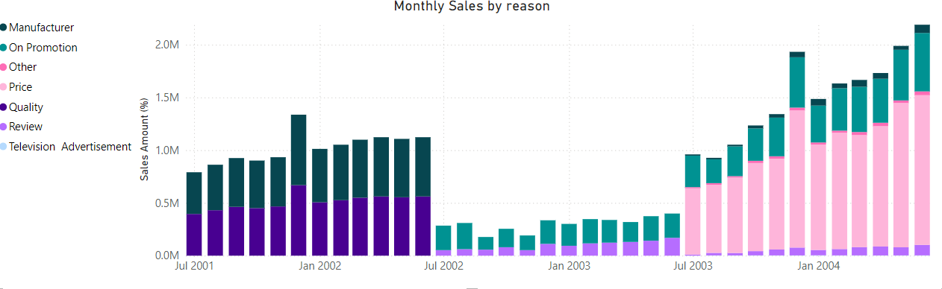
Monthly Sales by Reason
Price has been growing as the most reason for sales last years. We can focus on that.
Notes:
One of the key drivers behind our sales is price. Over the past years, it has consistently been the top reason customers choose to buy from us. This tells us that competitive pricing is a significant advantage for Adventure Works and a strong motivator for our customers

Slide 9
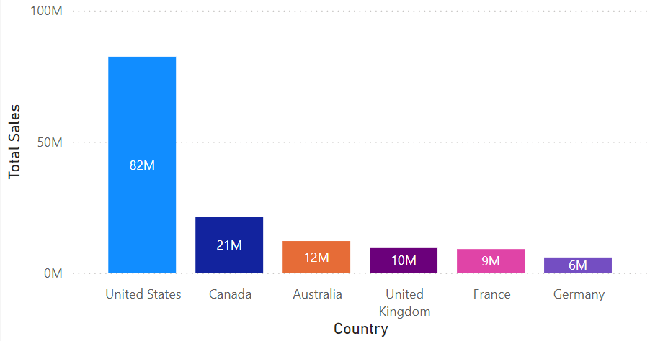
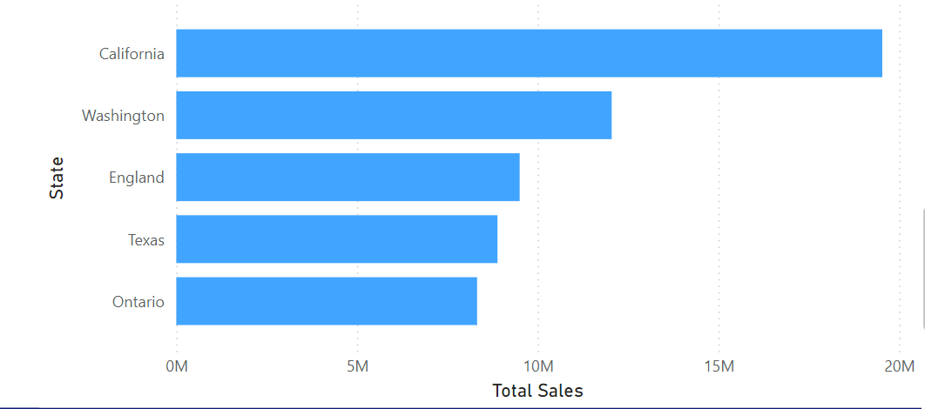
Opportunities and key recommendations
United states has generated the most sales, and California has the highest sales among the states. Targeting these regions by offline and online could increase the sales.
Top Countries by sales
Top States by sales
Notes:
Geographically, the United States leads our sales, with California as the top-performing state. This success provides a blueprint for other regions. By analyzing the factors contributing to California’s performance, we can adapt similar strategies elsewhere. Additionally, region-specific promotions and tailored offerings could help us tap into underperforming markets.

Slide 10
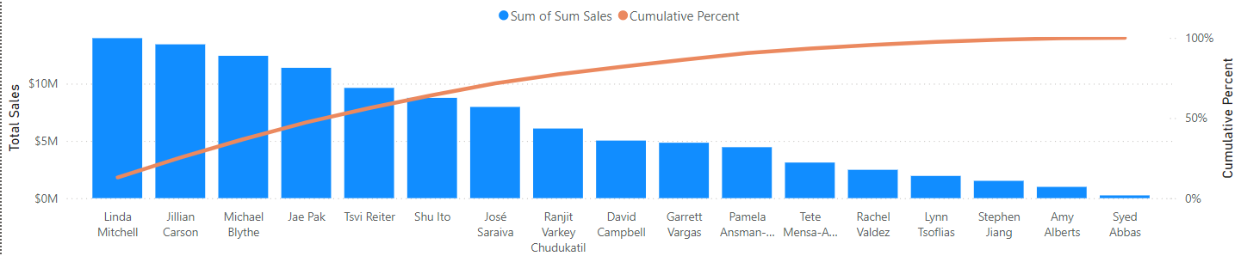
Top Sales People
Our two most performing sales people are Linda and Jilian, we could enhance the sales operations by making peer-peer training sessions by them to the lower performing employees
Notes:
Within our sales team, Linda and Jilian stand out as top performers. To harness their expertise, we recommend implementing peer-to-peer training sessions. These can help uplift lower-performing team members, while performance-based incentives can further motivate the entire sales force.

Slide 11
Key Recommendations
To wrap up, here are the three primary recommendations:
Boost online profitability by targeting marketing efforts and transitioning sales online.
Enhance sales team efficiency through training and incentivization.

Slide 12


